Slide 1
Infrastructure Automation with Terraform & Azure Devops on Azure cloud
Harshal Mittal

Slide 2
Setting up Backend Section 4
Notes:
Lets learn about the required resources of backend environment of the real life infrastructure scenario.

Slide 3
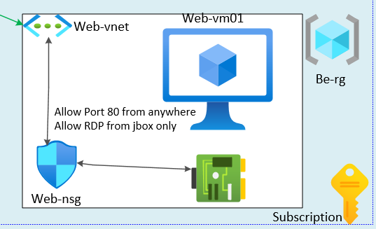
Setting up Backend
Backend portion of our lab.
Notes:
Let me show you the backend portion of the lab.
This is the backend portion of our lab, which I am going to set it up in this lab.

Slide 4
Backend resources
Be-rg (resource group)
Web-vnet (virtual network)
Web-subnet (subnet for webserver)
Web-interface ( Network interface for webserver)
Web-nsg (network security group)
Web-vm01 (Webserver virtual machine)
Notes:
Planning ahead is really imported before deploying resources.
As per my plan I am going to deploy following resources in this lab
A BE resource group.
A virtual network with 1 subnets for webserver,
And creating a network interface for webserver in the same subnet.
Creating a network security group and associate it with network interface of web-server.
And once I have deployed all the required components for the webserver then in the last I am going to deploy
Webserver vm. and then installing the webserver role on the windows server using automation and
In the last I am going to allow web traffic from any where to the webserver.
So again it is important to plan the things ahead before you deploy resources.
For example we are going to deploy a vnet, subnet and net interface before deploy a web server.
RDP to jbox will be setup in last part of this section when we are going to review the whole lab together.

Slide 5
Demo
Notes:
Let us deploy our back end environment in the lab, follow along.

Slide 6
Setting up the Jump box environment.
Next video
Notes:
Now we have setup our back end environment, In the next video I am going to setup our Jump box environment.

